Slide 1
Prioritise Trends
Priority trends for sustainability among Gen X in Australia
We’re here to help, get in touch:
collision-help@foresightfactory.co

Slide 2
Prioritise Trends
How I can improve my digital customer experience among Gen X in Australia
We’re here to help, get in touch:
collision-help@foresightfactory.co

Slide 3
Prioritise Trends
Trends impacting indulgence among daily snackers in EU average
We’re here to help, get in touch:
collision-help@foresightfactory.co

Slide 4
Prioritise Trends
How I can help customers cope with rising costs among living alone in Thailand
We’re here to help, get in touch:
collision-help@foresightfactory.co

Slide 5
Prioritise Trends
How I can help customers reach their aspirations among occasional online shoppers in USA
We’re here to help, get in touch:
collision-help@foresightfactory.co

Slide 6
Prioritise Trends
Opportunity trends in sports and fitness among weekly social networkers in APAC average
We’re here to help, get in touch:
collision-help@foresightfactory.co

Slide 7

1
Quantify Me
Self-tracking for the optimisation of life and planet

Slide 8
What is Quantify Me?
Self-tracking for the optimisation of life and planet
There is a growing desire to quantify more aspects of life. More and more consumers are engaging with self-monitoring tools that allow them to satisfy their self-curiosity and understand their performance versus their peers, whether in terms of physical activity, daily spending or home energy usage. While this trend has been on the horizon for several years (we first began tracking the quantified self movement in 2006), it is now being adopted by the mainstream consumer. In particular the COVID-19 pandemic boosted the desire to understand personal performance, particularly in terms of wellbeing, and this desire persists as consumers seek to improve their immunity levels, productivity and resilience to meet the demands of a post-pandemic world.
Diagnosis, prescriptions and recommendations are required. The driving need here is about more than just understanding – it is about acting. For many, the end goal of self-quantification is to optimise and hack their behaviour to ultimately be better and reach goals faster. And the metrics and accuracy with which consumers can track their habits and consumption is constantly expanding as technology improves and device makers strive for greater inclusivity.
There is a shift from individual to collective impact. Consumers increasingly want to understand the impact of their actions not just on their waistlines and wallets, but on the people around them and the wider world. Tools that provide insight into the environmental and ethical consequences of consumption choices are emerging – allowing consumers to see the carbon cost of a particular purchase, for example. This provides consumers with an additional lens with which to measure performance, and a more holistic view of “better” which doesn’t just include physical or mental metrics, but moral ones too.

Slide 9
What this means for: Loyalty
Reward consumers for sharing their data. Savvy shoppers are increasingly aware of the value of their personal data to companies, and many are prepared to share it in exchange it for benefits, as explored in our trend Data as Currency. The growth in measurement of various aspects of daily life generates a vast array of new data which can be exchanged for discounts and other rewards.
Tailor rewards using data gathered. Another advantage of harvesting a much wider array of customer data from loyalty programme members is brands can provide them with discounts and other rewards that are personalised to their needs and aspirations. Consumer habits relating to health, spending and the environment can all be monitored, to provide information on whether each individual would prefer complimentary carbon offsetting or discounted pricing, for instance.

Slide 10

2
War on Waste
Reducing, reusing, recycling and repairing in a bid to combat throwaway culture​

Slide 11
What is War on Waste?
Reducing, reusing, recycling and repairing in a bid to combat throwaway culture​
Consumer awareness of – and aversion to – waste is growing. Public awareness campaigns, documentaries and media have all served to raise awareness of wasteful practices and drive demand for a more sustainable future. Many consumers are making personal efforts to reduce waste at home. One response is simply buying less, but this is not always possible or a realistic option. For some, learning to repair and upcycle products – be they clothing, homewares or electronics – is an appealing alternative, especially as the popularity of DIY grows. ​
An increasing number of government and brand policies support waste-lite living. Some countries have introduced charges for single-use plastic bags. More brands are offering repair and end-of-life services, exploring circular models, switching to recycled or recyclable packaging, and celebrating “ugly” produce (i.e. fruit and vegetables) that would once have been considered unsellable. All of these initiatives speak to the consumer desire to rethink the buy-use-discard model.​
Rental, recommerce and resale bolster this trend. The recommerce industry has boomed in recent years, allowing consumers to sell their old and under-used items for cash instead of trashing them. Meanwhile, rental services are also expanding their reach and moving into new categories, meaning consumers can have temporary access to an item they might use only once, such as a wedding dress or DIY tool. Some fashion brands have launched rental-only product collections. At the same time, we see renewed interest in products that are built to last. These place an emphasis on quality and endurance – often costing more in terms of initial investment but providing significant long-term value.

Slide 12
What this means for: Loyalty
Tie rewards to recycling and waste avoidance. If sustainability and resource protection are core values for your brand, consider how you can incentivise your customers to adopt these values too. One route is to link loyalty points or discounts to waste-reducing behaviour like using in-store recycling bins, returning waste packaging for upcycling, or bringing reusable bags or containers to stores. ​
Maintain an aftermarket for your products. Engage customers even after the initial point of sale by involving your brand in the reselling process. For instance, consider allowing consumers to return unfinished or unused products for you to review, clean and resell. You could then offer rewards, discounts, store credit or donations to an eco-focused charity in exchange. This creates a touchpoint with the reseller and could also offer a valuable opportunity for feedback on why they do not wish to keep the product. ​

Slide 13
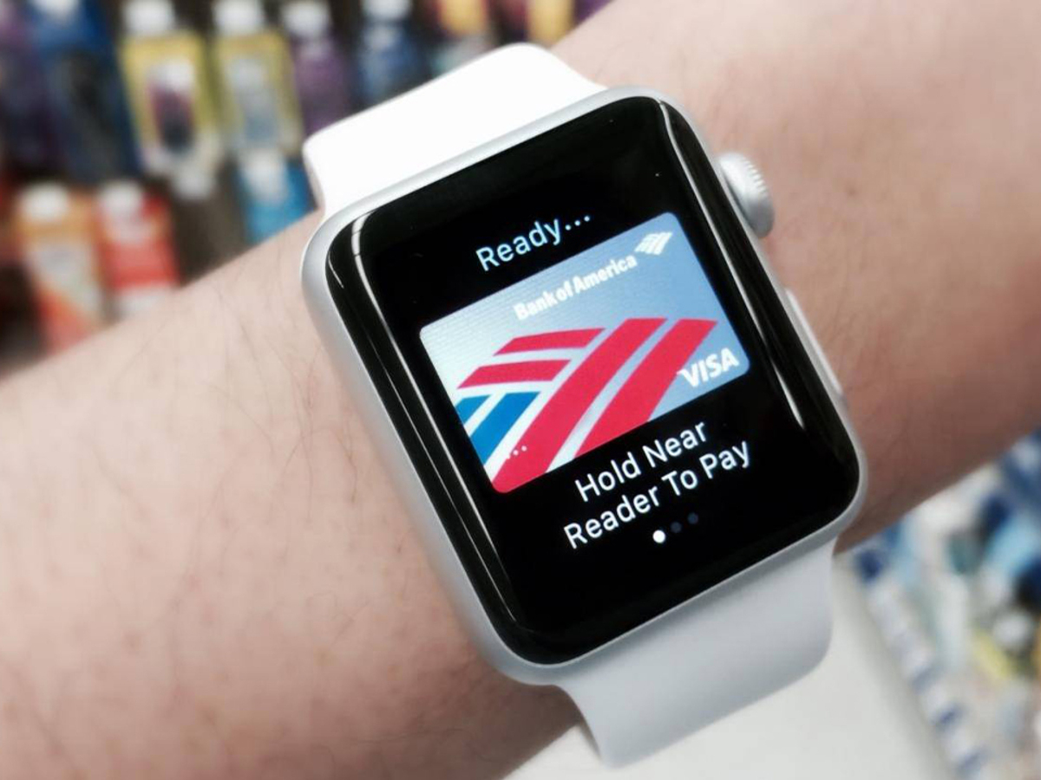
3
Cashless Society
Contactless, digital and biometric innovations transform payments ​

Slide 14
What is Cashless Society?
Contactless, digital and biometric innovations transform payments​
Contactless options are eliminating the need for cash. Contactless is speedy, secure, convenient and traceable. Alongside peer-to-peer apps and biometric identification, it has in many places eliminated the need for cash altogether. Cashless payment can also facilitate truly seamless transactions, removing the need for a time-consuming in-store checkout and even untethering the POS from IRL locations. For instance, concepts like Amazon Go use tech to verify identity and allow customers to simply walk out of the store to complete a purchase. ​
Digital innovations boost convenience and financial transparency. Contactless cards are slowly being supplanted by even more convenient methods of payment. Linking cards to mobile wallets loaded on smart watches means that the consumer can pay without ever reaching into their pocket. Iris recognition, face or thumbprint scans, plus innovations like subdermal implants remove the need for anything but the customer's physical presence. Meanwhile, tools that analyse spending for budgeting purposes can be integrated and automated in a Cashless Society, enabling consumers to exercise control over their incomings and outgoings. As more consumers adopt a digital-first approach to personal finances, this creates fertile ground for online-only challenger banks (and wealth management services), as well as alternatives to fiat currencies, such as cryptocurrencies. ​
However, barriers to complete cashlessness remain. Even as more cash-based businesses adopt mobile payments, many consumers are still wedded to cash – some out of choice, others out of necessity. Poorly-planned transitions to completely cashless transactions can leave groups like the unbanked and the underbanked unable to access services. Data anxiety and a desire for anonymity are also factors that could slow the uptake of cashless payments, given that non-cash purchases can be easily tracked. To earn trust, retailers and payment providers will need to tout their security credentials, and anonymised digital wallets and cryptocurrency might help here too.

Slide 15
What this means for: Loyalty
Recognise loyal customers at the point of sale. It is easier to recognise loyal and returning customers when they are paying via cashless means. This enables brands to integrate CRM information into the point of sale – for instance, automatically loading rewards points or vouchers onto a customer profile, without consumers needing to carry extra loyalty cards. Third parties are currently experimenting with consolidated loyalty and payment wallets.

Slide 16
Additional trends
Cashless Society: Contactless, digital and biometric innovations transform payments (x 0.247, y -4.560)
Gender Unbound: Renouncing traditional notions of gender and sex in favour of freedom and flexibility
Choice Partners: Looking to brands, platforms and trusted voices for decision-making shortcuts
Flexible Loyalty: Valuing low-commitment and flexible relationships with brands​
The Great Indoors: Wanting to spend time in the sanctuary of the home space​
Source: Foresight Factory

Slide 17
Additional trends
Cashless Society: Contactless, digital and biometric innovations transform payments (x 0.247, y -4.560)
Gender Unbound: Renouncing traditional notions of gender and sex in favour of freedom and flexibility
Choice Partners: Looking to brands, platforms and trusted voices for decision-making shortcuts
Flexible Loyalty: Valuing low-commitment and flexible relationships with brands​
The Great Indoors: Wanting to spend time in the sanctuary of the home space​
War on Waste: Reducing, reusing, recycling and repairing in a bid to combat throwaway culture​
War on Waste: Reducing, reusing, recycling and repairing in a bid to combat throwaway culture​
Cashless Society: Contactless, digital and biometric innovations transform payments
Gender Unbound: Renouncing traditional notions of gender and sex in favour of freedom and flexibility
Choice Partners: Looking to brands, platforms and trusted voices for decision-making shortcuts
Flexible Loyalty: Valuing low-commitment and flexible relationships with brands​
The Great Indoors: Wanting to spend time in the sanctuary of the home space​
War on Waste: Reducing, reusing, recycling and repairing in a bid to combat throwaway culture​
The Great Indoors: Wanting to spend time in the sanctuary of the home space​
Cashless Society: Contactless, digital and biometric innovations transform payments
Gender Unbound: Renouncing traditional notions of gender and sex in favour of freedom and flexibility
Choice Partners: Looking to brands, platforms and trusted voices for decision-making shortcuts
Flexible Loyalty: Valuing low-commitment and flexible relationships with brands​
The Great Indoors: Wanting to spend time in the sanctuary of the home space​
War on Waste: Reducing, reusing, recycling and repairing in a bid to combat throwaway culture​
The Great Indoors: Wanting to spend time in the sanctuary of the home space​
Source: Foresight Factory

Slide 18
collision-help@foresightfactory.co

